Slide 1
Shell Bootcamp 2024 – TECHNICAL FOUNDATION Reflections for Day 3 (02-Sep-2024)
Hitesh
Date : 06-Sep-2024

Slide 2

My learnings from this week!

Slide 3
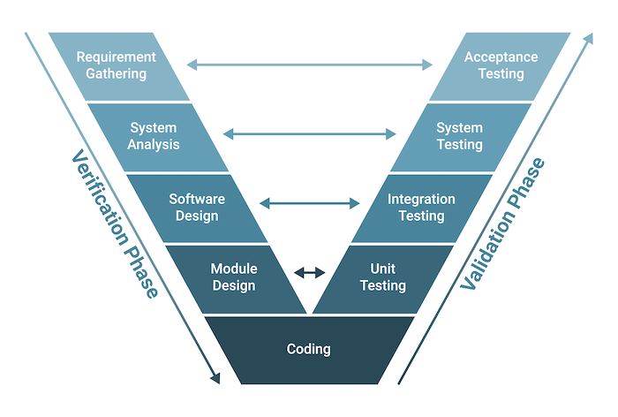
Learning 1 | My takeaways
Test
Definition: An activity where a system or component is executed under specific conditions, results are observed, and evaluations are made regarding some aspects.
Example: Running a test to verify that a login feature works correctly under normal conditions.
Software Testing
Definition: The process of evaluating and verifying that a software product or application does what it’s supposed to do. It helps identify bugs and ensure quality.
Where Testing Fits in SDLC (V-Model)
Description: In the V-Model (Validation and Verification Model), testing is integrated at every stage, starting from requirement analysis through to coding, with corresponding testing phases such as unit, integration, system, and acceptance testing.

Slide 4
Learning 2 | My takeaways
Software Failure
When a software application does not perform as expected due to bugs, errors, or environmental factors.
Example: An application crashes when a user attempts to upload a file.
Why Software Testing is Necessary
Because it ensures that software is free of defects, meets requirements, and provides a quality user experience, reducing the risk of failures post-release.
STLC (Software Testing Life Cycle)
A sequence of specific steps followed during the testing process to ensure that quality goals are met.
7 Phases:
Requirement Analysis: Analyzing the requirements to identify what needs to be tested and determine testable conditions.
Test Planning: Creating a test plan and strategy, defining the scope, objectives, resources, schedule, and deliverables.
Test Case Development: Designing detailed test cases and test scripts based on the requirements and planning.
Environment Setup: Preparing the necessary hardware, software, and network configurations for test execution.
Test Execution: Running the test cases in the test environment and recording the results.
Test Cycle Closure: Analyzing test results, evaluating test completion criteria, and closing the testing process with reports and documentation.

Slide 5
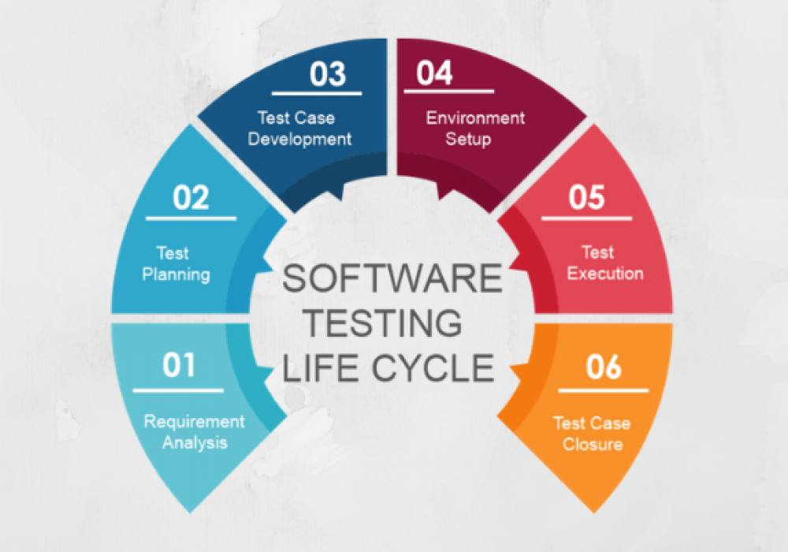
Learning 2 | My takeaways

Slide 6
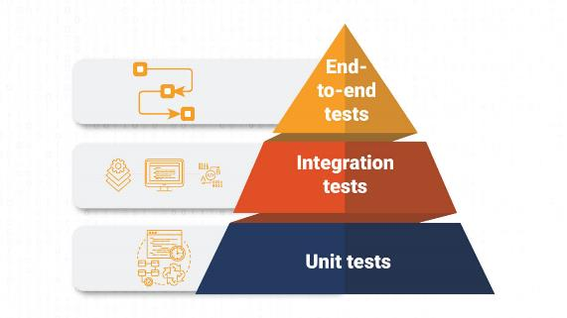
Learning 3 | My takeaways
SDLC vs. STLC
Description: SDLC (Software Development Life Cycle) focuses on the complete development process, while STLC is specifically concerned with the testing phase within the SDLC.
Testing Triangle
Definition: A model that represents the distribution of different types of tests in a software project, emphasizing a larger base of unit tests, followed by fewer integration tests, and even fewer end-to-end tests.
Example: Most tests should be unit tests, some should be integration tests, and the fewest should be UI or end-to-end tests.
Types of Software Testing
Static Testing: Involves reviewing documents and code without executing the software (e.g., code reviews, walkthroughs).
Dynamic Testing: Involves executing code and checking its behavior (e.g., functional testing).

Slide 7
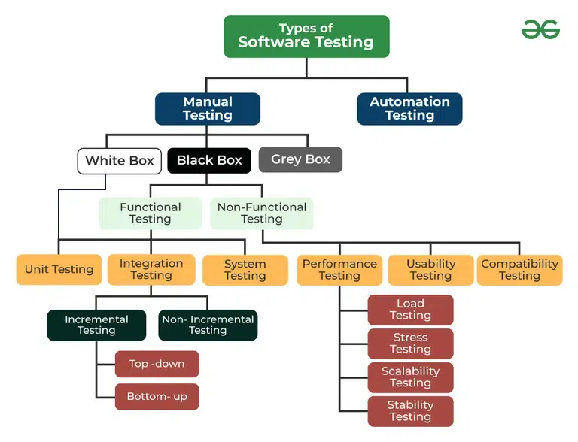
Learning 4 | My takeaways
Functional Testing: Verifies that the software performs its intended functions (e.g., testing a login form).
Non-Functional Testing: Checks non-functional aspects like performance, usability, and security (e.g., load testing).
Automation Testing
Definition: The use of software tools to execute pre-scripted tests on a software application before it is released into production.
Benefits: Increases efficiency, repeatability, and coverage of tests.
Which Test Cases to Automate and Not to Automate
Automate: Repetitive, high-risk, data-driven, or time-consuming tests.
Do Not Automate: Exploratory, ad-hoc, or UI tests that require human judgment.

Slide 8
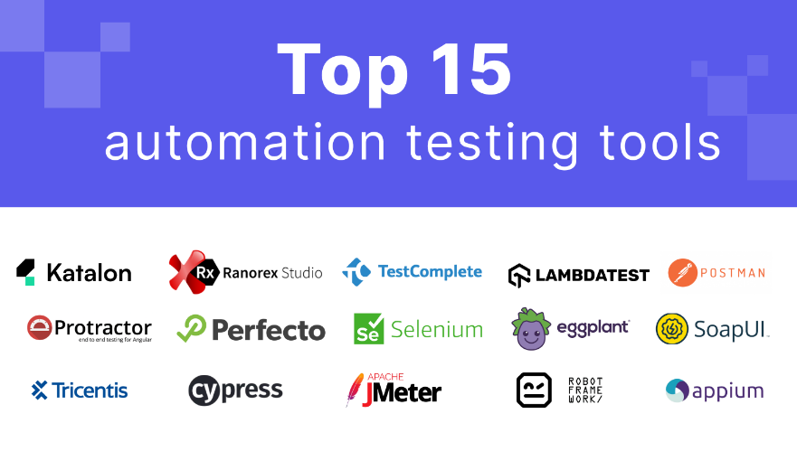
Learning 5 | My takeaways
Automation Testing Tools
Selenium, JUnit, TestNG, and Jenkins for continuous integration.
Unit Test
Definition: Testing individual components or modules of a software to verify that each part functions correctly in isolation.
Example: Testing a single function that calculates the total price of items in a shopping cart.

Slide 9
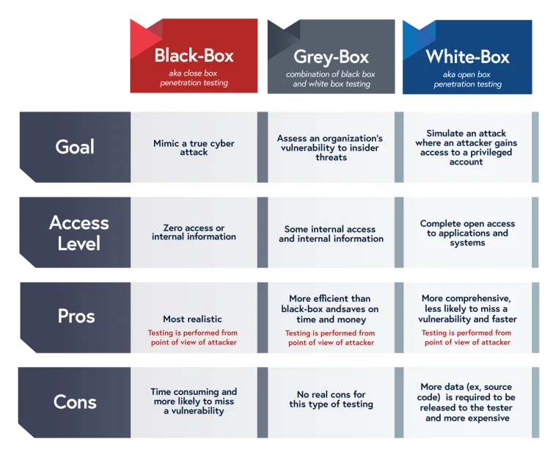
Learning 6 | My takeaways
Blackbox vs. Whitebox vs. Greybox Testing
Blackbox Testing: Testing without knowing the internal code structure. Focuses on inputs and outputs.
Example: Testing a user interface to ensure it behaves as expected.
Whitebox Testing: Testing with knowledge of the internal code structure. Focuses on testing the logic and flow.
Example: Writing tests that verify the path coverage of code.
Greybox Testing: A combination of both blackbox and whitebox testing, where testers have partial knowledge of the internal structure.
Example: Testing APIs with some understanding of how they work internally.

Slide 10
Thank You

